Slide 1
PHASE III
DISTANCE LEARNING

Slide 2

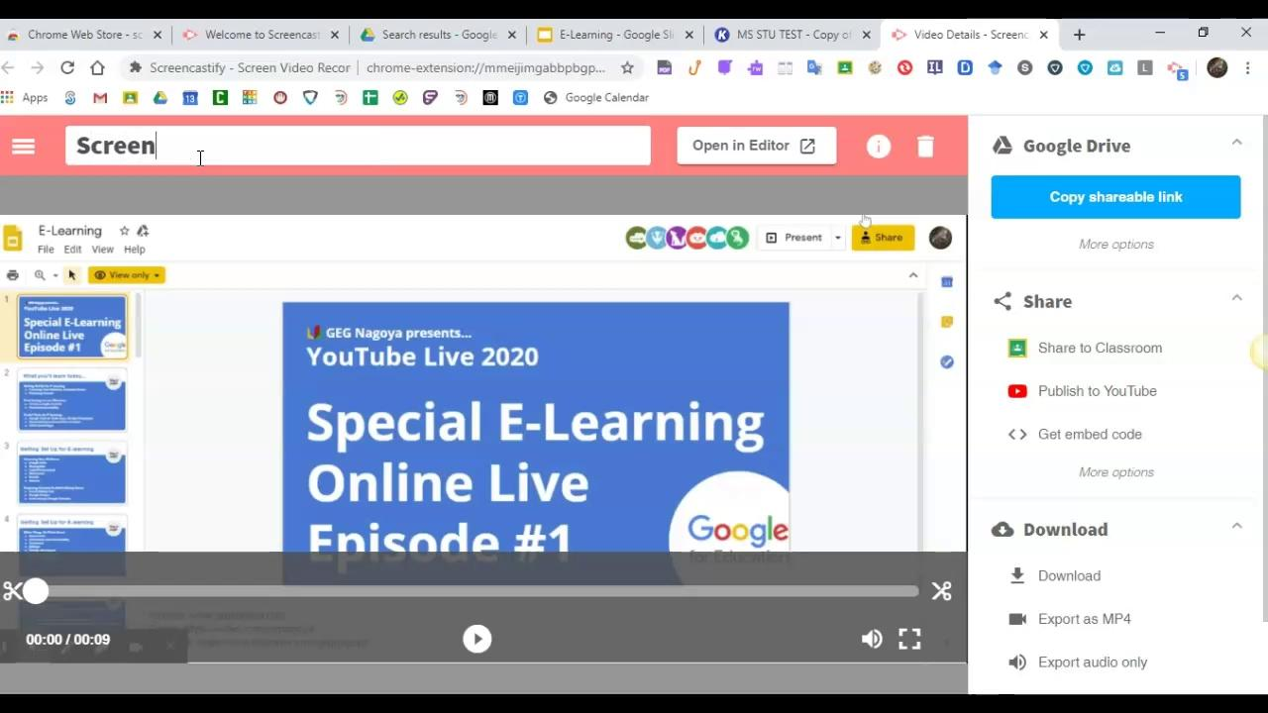
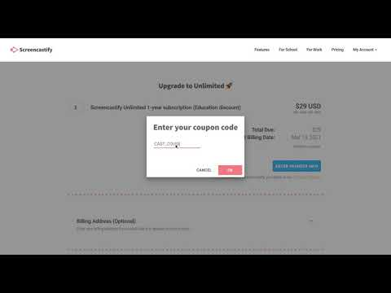
SCREENCASTING TO RECORD INSTRUCTIONAL VIDEOS FOR STUDENTS
SCREENCASTIFY
What is it?
Screencastify is a free Google Chrome extension that allows you to record your screen. These recorded videos can be shared with students.
SCREENCASTIFY
How to use it?
Upgrade to the Premium Version of Screencastify for Free!
Use the coupon code CAST_COVID

Slide 3

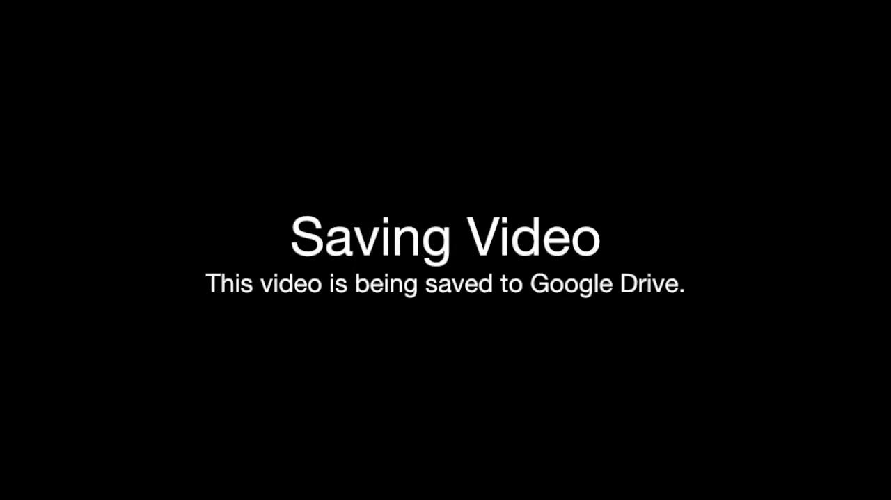

TAKING SCREENSHOTS
On a Chromebook
On a Windows PC
On a Mac
* Click inside the laptops to open links
Notes:
How to video

Slide 4
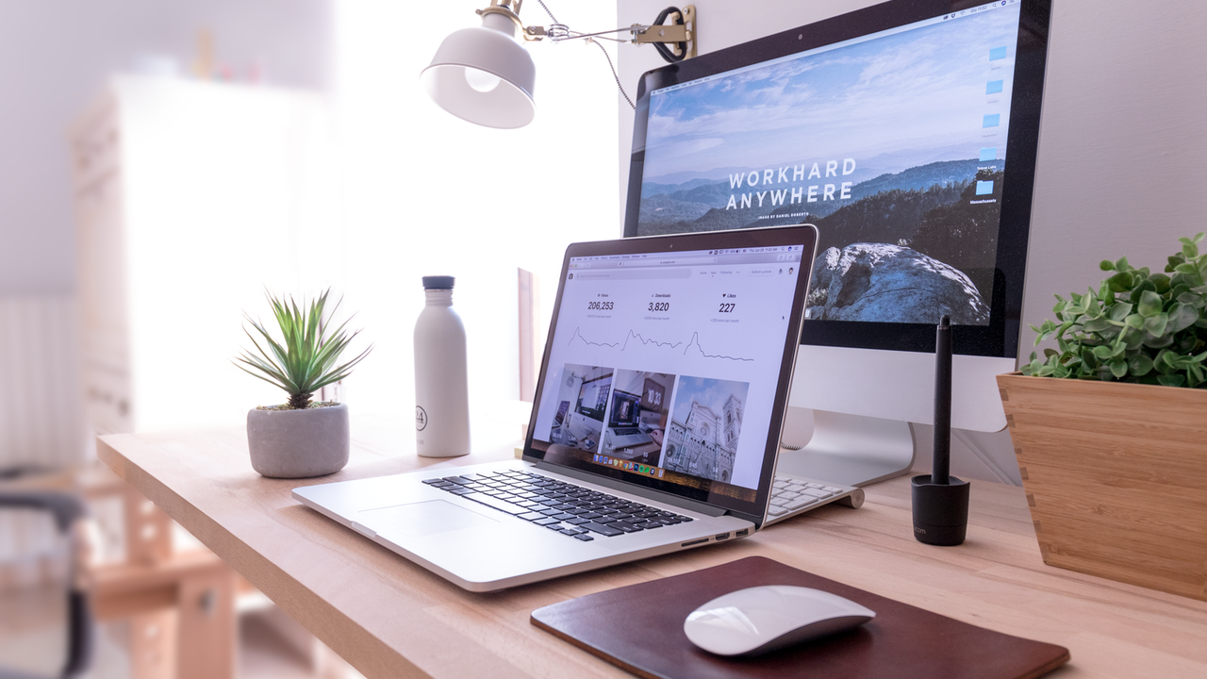
USING KAMI FOR EDITING PDFs
What is Kami?
Kami is software that allows the user to edit or mark up PDF files. For example, if a teacher wants to digitally assign a textbook page or workbook page, the student will be able to mark it up, and complete the assignment and hand it back to the teacher.

Slide 5
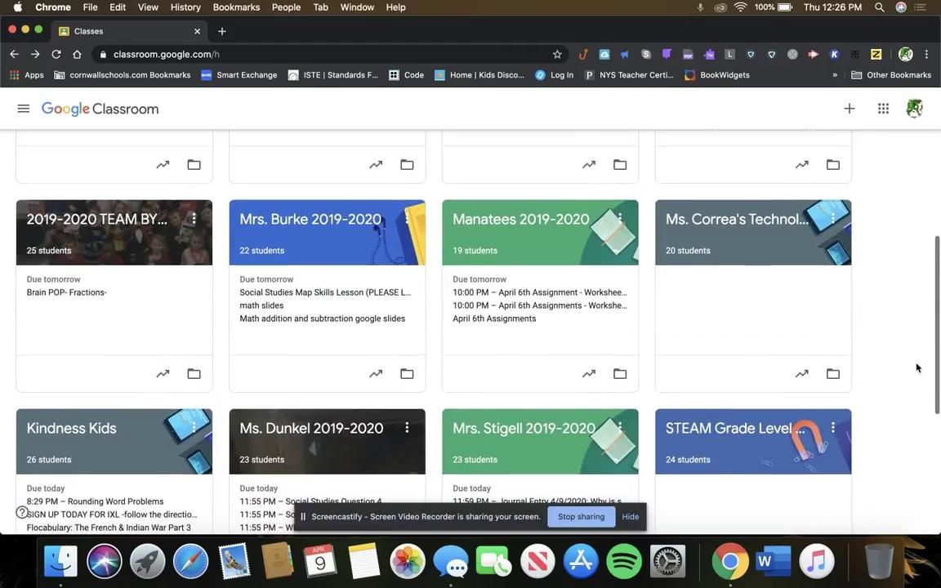


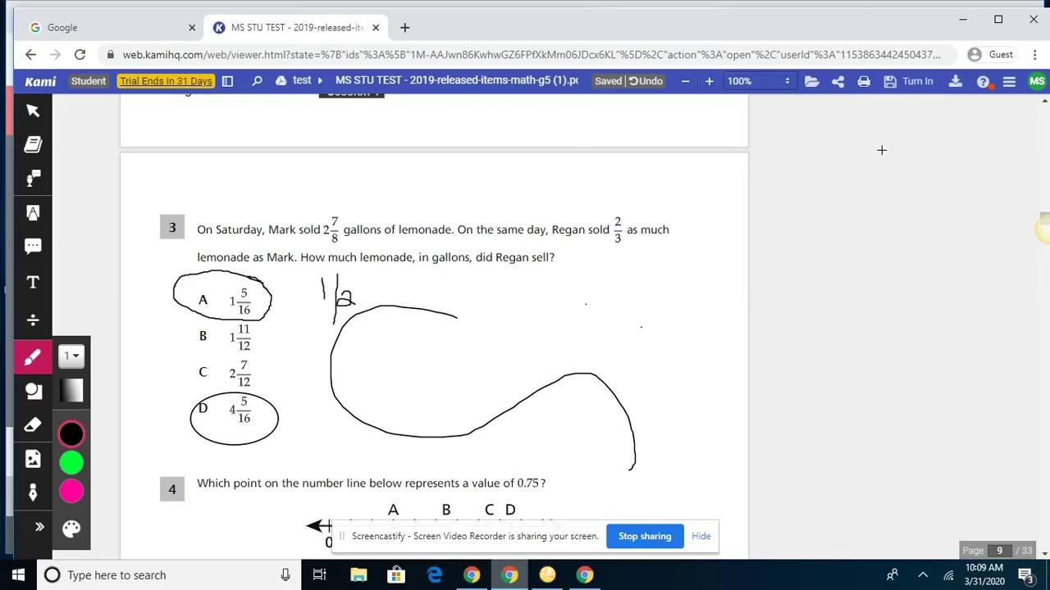
How to Sync
Kami for Students
* Click inside the laptops to open links
Kami for Teachers
Resolving Student Issues with Kami

Slide 6
GOOGLE MEET
What is it? Google Meet (formerly Google Hangouts) is a video conferencing platform offered in Google’s G Suite.
How to use it: Teachers can hold parent conferences, tutoring, office hours, and live instruction using Meet. Please see the next slide for instructional videos on how to get started.

Slide 7
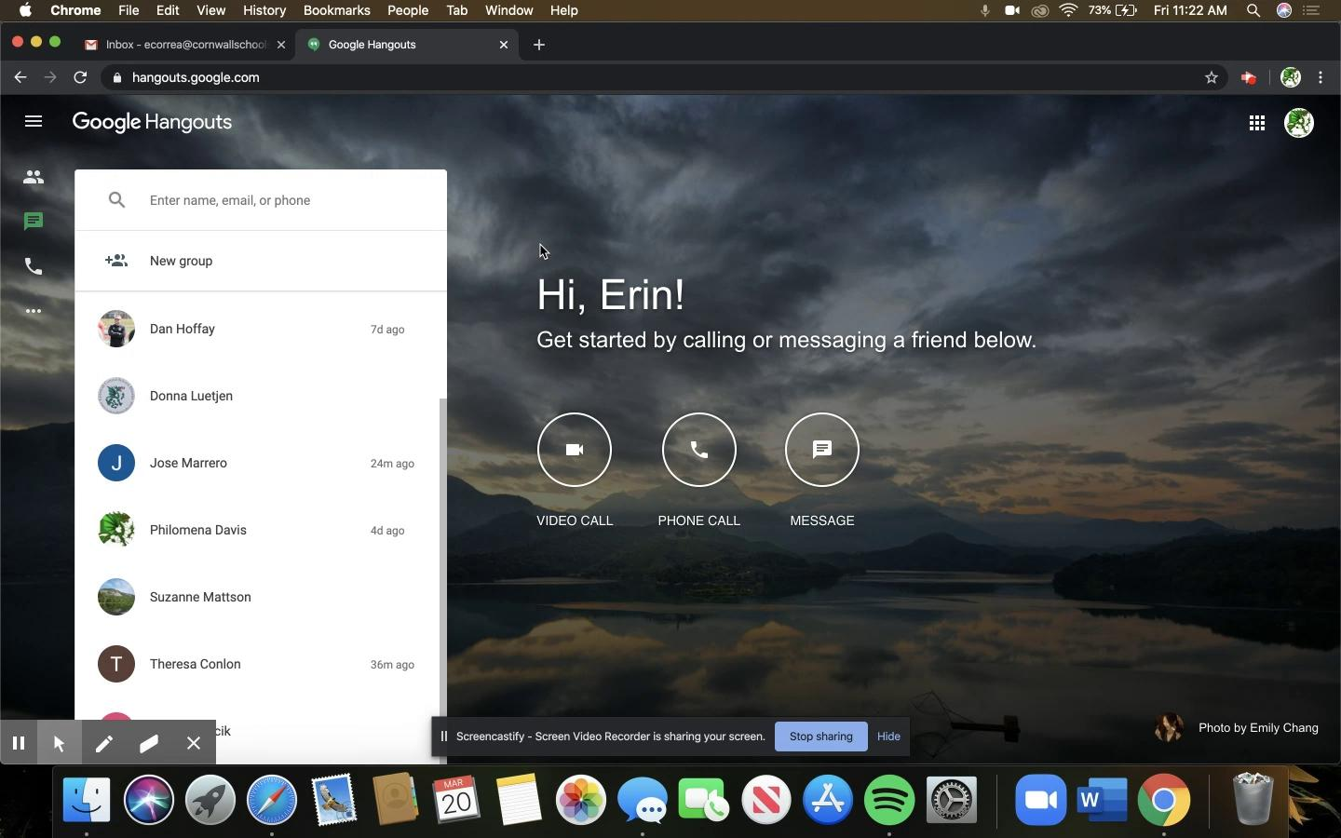


Introduction
How to Record Your Meeting
Step by Step- How to Host a Meeting
* Click inside the laptops to open links

Slide 8


Google Meet- Student Rules
Google Meet- Student View
* Click inside the laptops to open links
Nod for Google Meet- Student Directions
Whiteboard Extension

Slide 9
SMART Learning Suite Online
What is SMART Learning Suite?
SMART Learning Suites allows the teacher to access Smart Notebook lessons and share them to their students on any device. Students can complete interactive assignments on a tablet, PC, chromebook, or phone and learn at their own pace.

Slide 10
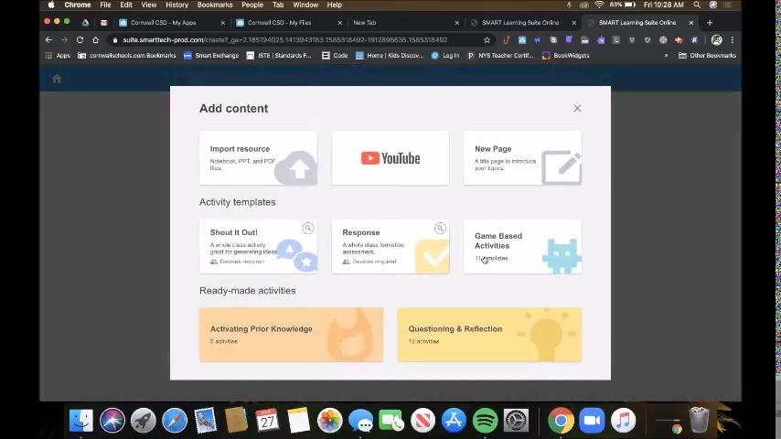


Introduction to SMART Learning Suite
Link for Students and Teachers
SMART Exchange
* Click inside the laptops to open links

Slide 11

Classlink
What is Classlink?
ClassLink LaunchPad gives you remote access to your files stored on a hard drive in another location.
* Use it to access files stored on your H Drive.

Slide 12

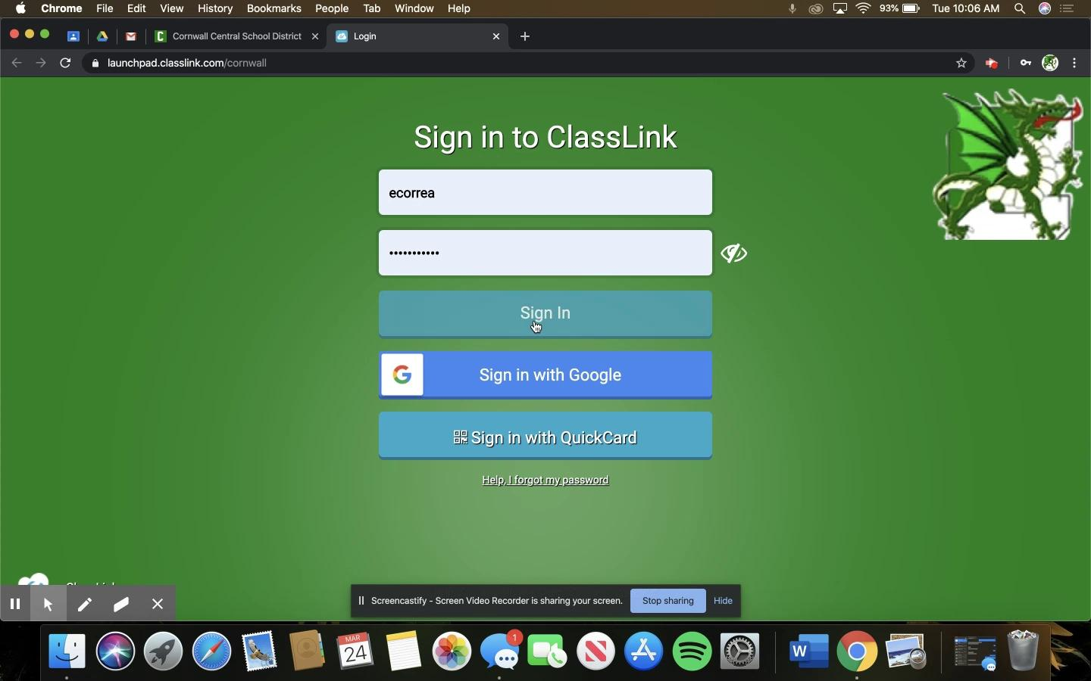
Classlink Website
How To Access Classlink
* Click inside the laptops to open links

Slide 13

LINKS TO MORE:
SCREENCASTIFY
KAMI
GOOGLE MEET
TRANSLATE ADD ON FOR GOOGLE SLIDES:
This is helpful for teachers of English Language Learners and ELL students
SMART LEARNING SUITE:

Slide 14
For help with any of these tools contact your Technology Integration Specialist
High School
Donna Luetjen
Contact Me
Middle School
Melanie Schweizer
Contact Me
Elementary School
Erin Correa
Contact Me

